Slide 1

UNIDAD III ANALISIS Y DISEÑO EN EL DESARROLLO DE SOFTWARE CON UML
3.4 Diagrama de secuencia
PROFESOR: BRENDA JUÁREZ SANTIAGO

Slide 2

3.4 DIAGRAMA DE SECUENCIA
CONCEPTO
Relação com investidores
20%
das empresas da Fortune 500 escolhem a Arkadin para seus anúncios a investidores
+ de 5000
anúncios a investidores por ano
2500
companias confiam na Arkadin para fazer seus anúncios a investidores
Es un diagrama que muestra el orden secuencial de los eventos y sucesos del sistema.
Notes:
Marketing & Sales
64% of marketing professionals view webcast as an innovative marketing and communication vehicle
46% of senior marketers predict that half of all corporate events will be hybrid this year
80% of virtual events help build stronger market presence, generate leads & drive awareness and education
Webcast is the #2 most effective marketing tool for nurturing & engaging prospects
Investor Relations (IR)
Corp Comms
Training & Cont. Education
-----
What are the most popular / effective vehicles for marketing activities today & what are the emerging trends?
- How rapidly are webcasts / webinars being adopted by marketing professionals?
- When is a virtual event a webcast vs a web conference?
- Case study: How webcasting is used at Arkadin to reduce budget and extend reach
Sources:
Business to Business B2B - 2012
4 Reasons Your Next Event Should Be a Virtual One – HubSpot, June 2011
Forresters – 2012
The Practicalities of Virtual Events – ON24, June 2011
Navigating the Emerging Gap in Large Conference Calls & Webcast Event Solutions – Wainhouse Research, 2013
4 Reasons Your Next Event Should Be a Virtual One – HubSpot, June 2011
Cost effectiveness
Global Reach
Increase sales
Reinforce brand awareness
Enhance engagement
Continue the conversation
Elongate the life of your event
Reduce carbon footprint
Reduce travel cost

Slide 3
3.4 DIAGRAMA DE SECUENCIA
Pertenece a los diagrama de iteración.
Muestran el intercambio de mensajes
Se realiza a partir de la descripción de un caso de uso
Relação com investidores
Características
Notes:
Marketing & Sales
64% of marketing professionals view webcast as an innovative marketing and communication vehicle
46% of senior marketers predict that half of all corporate events will be hybrid this year
80% of virtual events help build stronger market presence, generate leads & drive awareness and education
Webcast is the #2 most effective marketing tool for nurturing & engaging prospects
Investor Relations (IR)
Corp Comms
Training & Cont. Education
-----
What are the most popular / effective vehicles for marketing activities today & what are the emerging trends?
- How rapidly are webcasts / webinars being adopted by marketing professionals?
- When is a virtual event a webcast vs a web conference?
- Case study: How webcasting is used at Arkadin to reduce budget and extend reach
Sources:
Business to Business B2B - 2012
4 Reasons Your Next Event Should Be a Virtual One – HubSpot, June 2011
Forresters – 2012
The Practicalities of Virtual Events – ON24, June 2011
Navigating the Emerging Gap in Large Conference Calls & Webcast Event Solutions – Wainhouse Research, 2013
4 Reasons Your Next Event Should Be a Virtual One – HubSpot, June 2011
Cost effectiveness
Global Reach
Increase sales
Reinforce brand awareness
Enhance engagement
Continue the conversation
Elongate the life of your event
Reduce carbon footprint
Reduce travel cost

Slide 4
3.4 DIAGRAMA DE SECUENCIA
•Da la posibilidad de representar los mensajes en función del tiempo.
•La separación de los mensajes no indica intervalos o cantidades de tiempo, solo ordenación temporal.
•Es posible añadir restricciones temporales
Relação com investidores
Ventajas
Notes:
Marketing & Sales
64% of marketing professionals view webcast as an innovative marketing and communication vehicle
46% of senior marketers predict that half of all corporate events will be hybrid this year
80% of virtual events help build stronger market presence, generate leads & drive awareness and education
Webcast is the #2 most effective marketing tool for nurturing & engaging prospects
Investor Relations (IR)
Corp Comms
Training & Cont. Education
-----
What are the most popular / effective vehicles for marketing activities today & what are the emerging trends?
- How rapidly are webcasts / webinars being adopted by marketing professionals?
- When is a virtual event a webcast vs a web conference?
- Case study: How webcasting is used at Arkadin to reduce budget and extend reach
Sources:
Business to Business B2B - 2012
4 Reasons Your Next Event Should Be a Virtual One – HubSpot, June 2011
Forresters – 2012
The Practicalities of Virtual Events – ON24, June 2011
Navigating the Emerging Gap in Large Conference Calls & Webcast Event Solutions – Wainhouse Research, 2013
4 Reasons Your Next Event Should Be a Virtual One – HubSpot, June 2011
Cost effectiveness
Global Reach
Increase sales
Reinforce brand awareness
Enhance engagement
Continue the conversation
Elongate the life of your event
Reduce carbon footprint
Reduce travel cost

Slide 5
3.4 DIAGRAMA DE SECUENCIA
•Una representación de un diagrama de secuencia demasiado largo, puede ser difícilmente entendido por alguien ajeno al sistema.
Relação com investidores
Desventajas
Notes:
Marketing & Sales
64% of marketing professionals view webcast as an innovative marketing and communication vehicle
46% of senior marketers predict that half of all corporate events will be hybrid this year
80% of virtual events help build stronger market presence, generate leads & drive awareness and education
Webcast is the #2 most effective marketing tool for nurturing & engaging prospects
Investor Relations (IR)
Corp Comms
Training & Cont. Education
-----
What are the most popular / effective vehicles for marketing activities today & what are the emerging trends?
- How rapidly are webcasts / webinars being adopted by marketing professionals?
- When is a virtual event a webcast vs a web conference?
- Case study: How webcasting is used at Arkadin to reduce budget and extend reach
Sources:
Business to Business B2B - 2012
4 Reasons Your Next Event Should Be a Virtual One – HubSpot, June 2011
Forresters – 2012
The Practicalities of Virtual Events – ON24, June 2011
Navigating the Emerging Gap in Large Conference Calls & Webcast Event Solutions – Wainhouse Research, 2013
4 Reasons Your Next Event Should Be a Virtual One – HubSpot, June 2011
Cost effectiveness
Global Reach
Increase sales
Reinforce brand awareness
Enhance engagement
Continue the conversation
Elongate the life of your event
Reduce carbon footprint
Reduce travel cost

Slide 6

ELEMENTOS DEL DIAGRAMA DE SECUENCIA
El diagrama de secuencia en UML, indica la forma en la que los eventos provocan transiciones de un objeto a otro
Rol de la clase
Activación
Mensaje
Líneas de vida
Destrucción de objetos
Loops
Notes:
A number of components are required to be able to deliver professional events. We believes these are the four core strengths that enable us to deliver great events.

Slide 7
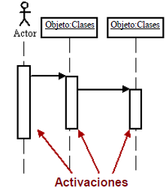

ELEMENTOS DEL DIAGRAMA DE SECUENCIA
ROL DE LA CLASE
ACTIVACIÓN
Describe la manera en que un objeto se va a comportar en el contexto
Representan el tiempo que un objeto necesita para completar una tarea.
Notes:
Small Meetings:
Collaborative tool for ad-hoc interactive meetings
Fully user-managed
No participant registration required
Limited branding and customisation options
Average participants: 5-15
Audio / Web / video seminar:
Planned meetings
Either self-service or operator manager event
Branding & registration may be required
Extensive reporting / analytics
Average participants: 5-15
Large scale events
Single broadcast (one-to-many) announcement for VIP or large audiences
Comprehensive participant registration and reporting tools capturing data on your attendees
Extensive branding options
End-to -end management support and consulting
Average participants: 50 and up

Slide 8
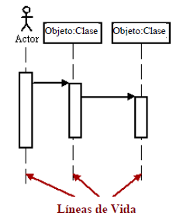
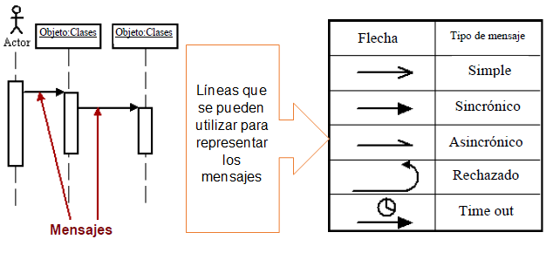
ELEMENTOS DEL DIAGRAMA DE SECUENCIA
MENSAJE
LÍNEAS DE VIDA
Son flechas que representan, el tipo de comunicaciones entre objetos.
Son verticales y en línea de segmentos, ellas indican la presencia del objeto durante el tiempo.
Notes:
Small Meetings:
Collaborative tool for ad-hoc interactive meetings
Fully user-managed
No participant registration required
Limited branding and customisation options
Average participants: 5-15
Audio / Web / video seminar:
Planned meetings
Either self-service or operator manager event
Branding & registration may be required
Extensive reporting / analytics
Average participants: 5-15
Large scale events
Single broadcast (one-to-many) announcement for VIP or large audiences
Comprehensive participant registration and reporting tools capturing data on your attendees
Extensive branding options
End-to -end management support and consulting
Average participants: 50 and up

Slide 9
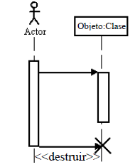
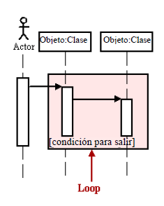
ELEMENTOS DEL DIAGRAMA DE SECUENCIA
DESTRUCCIÓN DE OBJETOS
Loops
Los objetos pueden ser eliminados tempranamente usando una flecha etiquetada “<<destruir>>” que apunta a una X.
Una repetición o loop en un diagrama de secuencias, es representado como un rectángulo.
Notes:
Small Meetings:
Collaborative tool for ad-hoc interactive meetings
Fully user-managed
No participant registration required
Limited branding and customisation options
Average participants: 5-15
Audio / Web / video seminar:
Planned meetings
Either self-service or operator manager event
Branding & registration may be required
Extensive reporting / analytics
Average participants: 5-15
Large scale events
Single broadcast (one-to-many) announcement for VIP or large audiences
Comprehensive participant registration and reporting tools capturing data on your attendees
Extensive branding options
End-to -end management support and consulting
Average participants: 50 and up

Slide 10
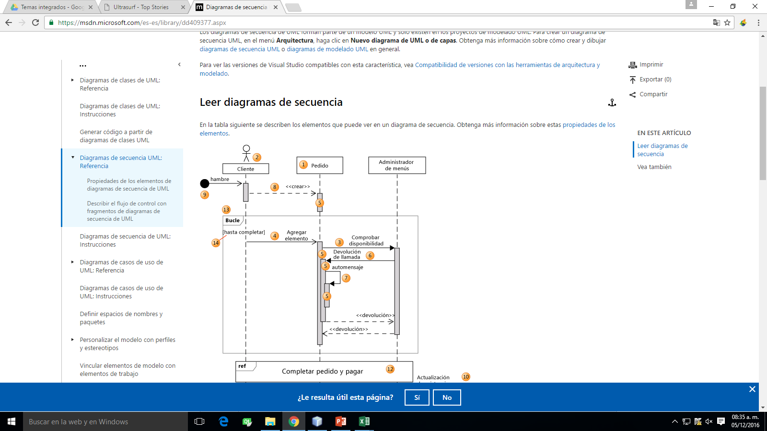
EJEMPLO DEL DIAGRAMA DE SECUENCIA
Sistema de venta de libros
administrador
Base de datos de libros
Libros
Modificación de libro
Nombre: | Administrador
Atributos Id_admin Nom_admin Pass_admin | Secuencia: Un administrador accede a la base de datos de libros en donde registra un libro, a dicho libro se le puede hacer una modificación, además de que puede ser también eliminado y al ser eliminado, se accede de nuevo a la base de datos de libros para dar de baja al libro
accede
registra
realiza
Elimina
Notes:
Small Meetings:
Collaborative tool for ad-hoc interactive meetings
Fully user-managed
No participant registration required
Limited branding and customisation options
Average participants: 5-15
Audio / Web / video seminar:
Planned meetings
Either self-service or operator manager event
Branding & registration may be required
Extensive reporting / analytics
Average participants: 5-15
Large scale events
Single broadcast (one-to-many) announcement for VIP or large audiences
Comprehensive participant registration and reporting tools capturing data on your attendees
Extensive branding options
End-to -end management support and consulting
Average participants: 50 and up

Slide 11
EJEMPLO DEL DIAGRAMA DE SECUENCIA
Sistema de venta de libros
Usuario registrado
Pagina web
Valida usuario
Libros
Base de datos de libros
Nombre: | Usuario registrado
Atributos Id_usu nombre_usu Fec_nac Correo_usu Password_usu Tel_usu tipo | Secuencia: Un usuario registrado accede a la pagina web en donde se valida si esta registrado para poder publicar o eliminar un libro los cuales se guardan o se eliminan de la base de datos de los libros
accede
registra
publica
inserta
elimina
Notes:
Small Meetings:
Collaborative tool for ad-hoc interactive meetings
Fully user-managed
No participant registration required
Limited branding and customisation options
Average participants: 5-15
Audio / Web / video seminar:
Planned meetings
Either self-service or operator manager event
Branding & registration may be required
Extensive reporting / analytics
Average participants: 5-15
Large scale events
Single broadcast (one-to-many) announcement for VIP or large audiences
Comprehensive participant registration and reporting tools capturing data on your attendees
Extensive branding options
End-to -end management support and consulting
Average participants: 50 and up

Slide 12
EJEMPLO DEL DIAGRAMA DE SECUENCIA
Sistema de venta de libros
Nombre: | Usuario registrado
Atributos Id_usu nombre_usu Fec_nac Correo_usu Password_usu Tel_usu tipo | Secuencia: Un usuario registrado accede a la pagina web, en donde puede publicar en su blog y las publicaciones se insertan en la base de datos de usuarios, y las publicaciones el usuario las puede ver como novedades
Pagina web
blog
Base de datos de usuarios
novedades
accede
publica
inserta
ver
Notes:
Small Meetings:
Collaborative tool for ad-hoc interactive meetings
Fully user-managed
No participant registration required
Limited branding and customisation options
Average participants: 5-15
Audio / Web / video seminar:
Planned meetings
Either self-service or operator manager event
Branding & registration may be required
Extensive reporting / analytics
Average participants: 5-15
Large scale events
Single broadcast (one-to-many) announcement for VIP or large audiences
Comprehensive participant registration and reporting tools capturing data on your attendees
Extensive branding options
End-to -end management support and consulting
Average participants: 50 and up

Slide 13
EJEMPLO DEL DIAGRAMA DE SECUENCIA
Sistema de venta de libros
Base de datos de usuarios
libro
Nombre: | Usuario no registrado
Atributos Id_usu nombre_usu Fec_nac Correo_usu Password_usu Tel_usu tipo | Secuencia: Un usuario no registrado accede a la pagina web y se registra en la base de datos de usuarios, al registrarse se valida como un usuario registrado. Al comprar un libro se crea una factura la cual se registra en la base de datos de ventas.
Pagina web
Usuario registrado
factura
Base de datos de ventas
accede
registra
valida
compra
crea
registra
Notes:
Small Meetings:
Collaborative tool for ad-hoc interactive meetings
Fully user-managed
No participant registration required
Limited branding and customisation options
Average participants: 5-15
Audio / Web / video seminar:
Planned meetings
Either self-service or operator manager event
Branding & registration may be required
Extensive reporting / analytics
Average participants: 5-15
Large scale events
Single broadcast (one-to-many) announcement for VIP or large audiences
Comprehensive participant registration and reporting tools capturing data on your attendees
Extensive branding options
End-to -end management support and consulting
Average participants: 50 and up

