Slide 1

UNIDAD III ANÁLISIS Y DISEÑO EN EL DESARROLLO DE SOFTWARE
3.5 DIAGRAMA DE COLABORACÓN
PROFESOR: BRENDA JUÁREZ SANTIAGO

Slide 2

3.5 DIAGRAMA DE COLABORACIÓN
DEFINICION
El diagrama de colaboración es un tipo de diagrama de interacción cuyo objetivo es describir el comportamiento dinámico del sistema de información mostrando cómo interactúan los objetos entre sí.
Relação com investidores
20%
das empresas da Fortune 500 escolhem a Arkadin para seus anúncios a investidores
+ de 5000
anúncios a investidores por ano
2500
companias confiam na Arkadin para fazer seus anúncios a investidores
Notes:
Marketing & Sales
64% of marketing professionals view webcast as an innovative marketing and communication vehicle
46% of senior marketers predict that half of all corporate events will be hybrid this year
80% of virtual events help build stronger market presence, generate leads & drive awareness and education
Webcast is the #2 most effective marketing tool for nurturing & engaging prospects
Investor Relations (IR)
Corp Comms
Training & Cont. Education
-----
What are the most popular / effective vehicles for marketing activities today & what are the emerging trends?
- How rapidly are webcasts / webinars being adopted by marketing professionals?
- When is a virtual event a webcast vs a web conference?
- Case study: How webcasting is used at Arkadin to reduce budget and extend reach
Sources:
Business to Business B2B - 2012
4 Reasons Your Next Event Should Be a Virtual One – HubSpot, June 2011
Forresters – 2012
The Practicalities of Virtual Events – ON24, June 2011
Navigating the Emerging Gap in Large Conference Calls & Webcast Event Solutions – Wainhouse Research, 2013
4 Reasons Your Next Event Should Be a Virtual One – HubSpot, June 2011
Cost effectiveness
Global Reach
Increase sales
Reinforce brand awareness
Enhance engagement
Continue the conversation
Elongate the life of your event
Reduce carbon footprint
Reduce travel cost

Slide 3
3.5 DIAGRAMA DE COLABORACIÓN
Muestra cómo las instancias específicas de las clases trabajan juntas para conseguir un objetivo común.
Implementa las asociaciones del diagrama de clases mediante el paso de mensajes de un objeto a otro. Dicha implementación es llamada "enlace”.
Relação com investidores
CARACTERÍSTICAS
Notes:
Marketing & Sales
64% of marketing professionals view webcast as an innovative marketing and communication vehicle
46% of senior marketers predict that half of all corporate events will be hybrid this year
80% of virtual events help build stronger market presence, generate leads & drive awareness and education
Webcast is the #2 most effective marketing tool for nurturing & engaging prospects
Investor Relations (IR)
Corp Comms
Training & Cont. Education
-----
What are the most popular / effective vehicles for marketing activities today & what are the emerging trends?
- How rapidly are webcasts / webinars being adopted by marketing professionals?
- When is a virtual event a webcast vs a web conference?
- Case study: How webcasting is used at Arkadin to reduce budget and extend reach
Sources:
Business to Business B2B - 2012
4 Reasons Your Next Event Should Be a Virtual One – HubSpot, June 2011
Forresters – 2012
The Practicalities of Virtual Events – ON24, June 2011
Navigating the Emerging Gap in Large Conference Calls & Webcast Event Solutions – Wainhouse Research, 2013
4 Reasons Your Next Event Should Be a Virtual One – HubSpot, June 2011
Cost effectiveness
Global Reach
Increase sales
Reinforce brand awareness
Enhance engagement
Continue the conversation
Elongate the life of your event
Reduce carbon footprint
Reduce travel cost

Slide 4
3.5 DIAGRAMA DE COLABORACIÓN
Permite elegir el orden en que pueden hacerse las cosas.
Puede describir procesos o casos de uso.
Muestra los aspectos dinámicos de un sistema.
Establece las reglas de secuencia a seguir.
Ayuda a un programador a desarrollar código a través de una descripción lógica de un proceso.
Relação com investidores
VENTAJAS
Notes:
Marketing & Sales
64% of marketing professionals view webcast as an innovative marketing and communication vehicle
46% of senior marketers predict that half of all corporate events will be hybrid this year
80% of virtual events help build stronger market presence, generate leads & drive awareness and education
Webcast is the #2 most effective marketing tool for nurturing & engaging prospects
Investor Relations (IR)
Corp Comms
Training & Cont. Education
-----
What are the most popular / effective vehicles for marketing activities today & what are the emerging trends?
- How rapidly are webcasts / webinars being adopted by marketing professionals?
- When is a virtual event a webcast vs a web conference?
- Case study: How webcasting is used at Arkadin to reduce budget and extend reach
Sources:
Business to Business B2B - 2012
4 Reasons Your Next Event Should Be a Virtual One – HubSpot, June 2011
Forresters – 2012
The Practicalities of Virtual Events – ON24, June 2011
Navigating the Emerging Gap in Large Conference Calls & Webcast Event Solutions – Wainhouse Research, 2013
4 Reasons Your Next Event Should Be a Virtual One – HubSpot, June 2011
Cost effectiveness
Global Reach
Increase sales
Reinforce brand awareness
Enhance engagement
Continue the conversation
Elongate the life of your event
Reduce carbon footprint
Reduce travel cost

Slide 5
3.5 DIAGRAMA DE COLABORACIÓN
Permite elegir el orden en que pueden hacerse las cosas.
Puede describir procesos o casos de uso.
Muestra los aspectos dinámicos de un sistema.
Establece las reglas de secuencia a seguir.
Ayuda a un programador a desarrollar código a través de una descripción lógica de un proceso.
Relação com investidores
DESVENTAJAS
Notes:
Marketing & Sales
64% of marketing professionals view webcast as an innovative marketing and communication vehicle
46% of senior marketers predict that half of all corporate events will be hybrid this year
80% of virtual events help build stronger market presence, generate leads & drive awareness and education
Webcast is the #2 most effective marketing tool for nurturing & engaging prospects
Investor Relations (IR)
Corp Comms
Training & Cont. Education
-----
What are the most popular / effective vehicles for marketing activities today & what are the emerging trends?
- How rapidly are webcasts / webinars being adopted by marketing professionals?
- When is a virtual event a webcast vs a web conference?
- Case study: How webcasting is used at Arkadin to reduce budget and extend reach
Sources:
Business to Business B2B - 2012
4 Reasons Your Next Event Should Be a Virtual One – HubSpot, June 2011
Forresters – 2012
The Practicalities of Virtual Events – ON24, June 2011
Navigating the Emerging Gap in Large Conference Calls & Webcast Event Solutions – Wainhouse Research, 2013
4 Reasons Your Next Event Should Be a Virtual One – HubSpot, June 2011
Cost effectiveness
Global Reach
Increase sales
Reinforce brand awareness
Enhance engagement
Continue the conversation
Elongate the life of your event
Reduce carbon footprint
Reduce travel cost

Slide 6
3.5 DIAGRAMA DE COLABORACIÓN
ELEMENTOS
Objetos Activos
Objetos múltiples (multiobjetos)
Enlaces o comunicaciones: arcos del grafo
Mensajes
Etiquetas del mensaje
Expresión de secuencia
Relação com investidores
Notes:
Marketing & Sales
64% of marketing professionals view webcast as an innovative marketing and communication vehicle
46% of senior marketers predict that half of all corporate events will be hybrid this year
80% of virtual events help build stronger market presence, generate leads & drive awareness and education
Webcast is the #2 most effective marketing tool for nurturing & engaging prospects
Investor Relations (IR)
Corp Comms
Training & Cont. Education
-----
What are the most popular / effective vehicles for marketing activities today & what are the emerging trends?
- How rapidly are webcasts / webinars being adopted by marketing professionals?
- When is a virtual event a webcast vs a web conference?
- Case study: How webcasting is used at Arkadin to reduce budget and extend reach
Sources:
Business to Business B2B - 2012
4 Reasons Your Next Event Should Be a Virtual One – HubSpot, June 2011
Forresters – 2012
The Practicalities of Virtual Events – ON24, June 2011
Navigating the Emerging Gap in Large Conference Calls & Webcast Event Solutions – Wainhouse Research, 2013
4 Reasons Your Next Event Should Be a Virtual One – HubSpot, June 2011
Cost effectiveness
Global Reach
Increase sales
Reinforce brand awareness
Enhance engagement
Continue the conversation
Elongate the life of your event
Reduce carbon footprint
Reduce travel cost

Slide 7
3.5 DIAGRAMA DE COLABORACIÓN
OBJETOS AVTIVOS
Un objeto activo puede activar un objeto pasivo por el tiempo de una operación enviándole un mensaje.
Un objeto activo se representa por un rectángulo cuyo borde es más grueso que el de los objetos pasivos.
Relação com investidores
Notes:
Marketing & Sales
64% of marketing professionals view webcast as an innovative marketing and communication vehicle
46% of senior marketers predict that half of all corporate events will be hybrid this year
80% of virtual events help build stronger market presence, generate leads & drive awareness and education
Webcast is the #2 most effective marketing tool for nurturing & engaging prospects
Investor Relations (IR)
Corp Comms
Training & Cont. Education
-----
What are the most popular / effective vehicles for marketing activities today & what are the emerging trends?
- How rapidly are webcasts / webinars being adopted by marketing professionals?
- When is a virtual event a webcast vs a web conference?
- Case study: How webcasting is used at Arkadin to reduce budget and extend reach
Sources:
Business to Business B2B - 2012
4 Reasons Your Next Event Should Be a Virtual One – HubSpot, June 2011
Forresters – 2012
The Practicalities of Virtual Events – ON24, June 2011
Navigating the Emerging Gap in Large Conference Calls & Webcast Event Solutions – Wainhouse Research, 2013
4 Reasons Your Next Event Should Be a Virtual One – HubSpot, June 2011
Cost effectiveness
Global Reach
Increase sales
Reinforce brand awareness
Enhance engagement
Continue the conversation
Elongate the life of your event
Reduce carbon footprint
Reduce travel cost

Slide 8
3.5 DIAGRAMA DE COLABORACIÓN
OBJETOS MULTIPLES (MULTIOBJETOS)
Alude a un rol de clasificador que denota un conjunto de objetos y no un objeto único. Generalmente es el conjunto de objetos del extremo muchos de una asociación.
Relação com investidores
Notes:
Marketing & Sales
64% of marketing professionals view webcast as an innovative marketing and communication vehicle
46% of senior marketers predict that half of all corporate events will be hybrid this year
80% of virtual events help build stronger market presence, generate leads & drive awareness and education
Webcast is the #2 most effective marketing tool for nurturing & engaging prospects
Investor Relations (IR)
Corp Comms
Training & Cont. Education
-----
What are the most popular / effective vehicles for marketing activities today & what are the emerging trends?
- How rapidly are webcasts / webinars being adopted by marketing professionals?
- When is a virtual event a webcast vs a web conference?
- Case study: How webcasting is used at Arkadin to reduce budget and extend reach
Sources:
Business to Business B2B - 2012
4 Reasons Your Next Event Should Be a Virtual One – HubSpot, June 2011
Forresters – 2012
The Practicalities of Virtual Events – ON24, June 2011
Navigating the Emerging Gap in Large Conference Calls & Webcast Event Solutions – Wainhouse Research, 2013
4 Reasons Your Next Event Should Be a Virtual One – HubSpot, June 2011
Cost effectiveness
Global Reach
Increase sales
Reinforce brand awareness
Enhance engagement
Continue the conversation
Elongate the life of your event
Reduce carbon footprint
Reduce travel cost

Slide 9
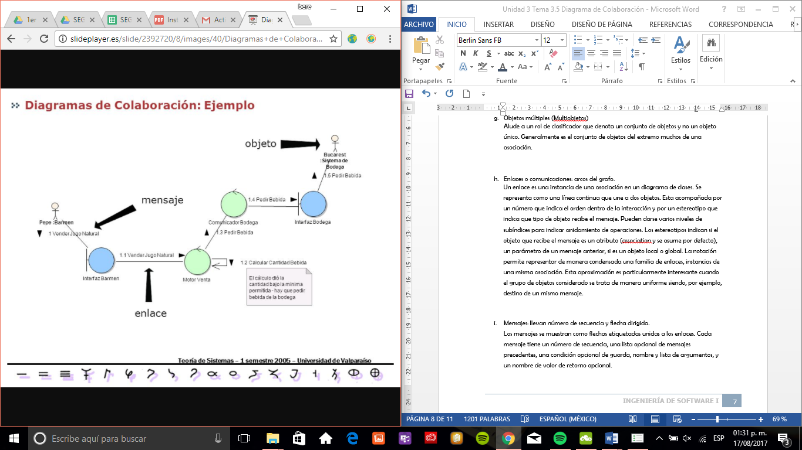
3.5 DIAGRAMA DE COLABORACIÓN
ENLACES O COMUNICACIONES
Un enlace es una instancia de una asociación en un diagrama de clases. Se representa como una línea continua que une a dos objetos. Esta acompañada por un número que indica el orden dentro de la interacción y por un estereotipo que indica que tipo de objeto recibe el mensaje.
Relação com investidores
Notes:
Marketing & Sales
64% of marketing professionals view webcast as an innovative marketing and communication vehicle
46% of senior marketers predict that half of all corporate events will be hybrid this year
80% of virtual events help build stronger market presence, generate leads & drive awareness and education
Webcast is the #2 most effective marketing tool for nurturing & engaging prospects
Investor Relations (IR)
Corp Comms
Training & Cont. Education
-----
What are the most popular / effective vehicles for marketing activities today & what are the emerging trends?
- How rapidly are webcasts / webinars being adopted by marketing professionals?
- When is a virtual event a webcast vs a web conference?
- Case study: How webcasting is used at Arkadin to reduce budget and extend reach
Sources:
Business to Business B2B - 2012
4 Reasons Your Next Event Should Be a Virtual One – HubSpot, June 2011
Forresters – 2012
The Practicalities of Virtual Events – ON24, June 2011
Navigating the Emerging Gap in Large Conference Calls & Webcast Event Solutions – Wainhouse Research, 2013
4 Reasons Your Next Event Should Be a Virtual One – HubSpot, June 2011
Cost effectiveness
Global Reach
Increase sales
Reinforce brand awareness
Enhance engagement
Continue the conversation
Elongate the life of your event
Reduce carbon footprint
Reduce travel cost

Slide 10
3.5 DIAGRAMA DE COLABORACIÓN
MENSAJES
Los mensajes se muestran como flechas etiquetadas unidas a los enlaces. Cada mensaje tiene un número de secuencia, una lista opcional de mensajes precedentes, una condición opcional de guarda, nombre y lista de argumentos, y un nombre de valor de retorno opcional
Relação com investidores
Notes:
Marketing & Sales
64% of marketing professionals view webcast as an innovative marketing and communication vehicle
46% of senior marketers predict that half of all corporate events will be hybrid this year
80% of virtual events help build stronger market presence, generate leads & drive awareness and education
Webcast is the #2 most effective marketing tool for nurturing & engaging prospects
Investor Relations (IR)
Corp Comms
Training & Cont. Education
-----
What are the most popular / effective vehicles for marketing activities today & what are the emerging trends?
- How rapidly are webcasts / webinars being adopted by marketing professionals?
- When is a virtual event a webcast vs a web conference?
- Case study: How webcasting is used at Arkadin to reduce budget and extend reach
Sources:
Business to Business B2B - 2012
4 Reasons Your Next Event Should Be a Virtual One – HubSpot, June 2011
Forresters – 2012
The Practicalities of Virtual Events – ON24, June 2011
Navigating the Emerging Gap in Large Conference Calls & Webcast Event Solutions – Wainhouse Research, 2013
4 Reasons Your Next Event Should Be a Virtual One – HubSpot, June 2011
Cost effectiveness
Global Reach
Increase sales
Reinforce brand awareness
Enhance engagement
Continue the conversation
Elongate the life of your event
Reduce carbon footprint
Reduce travel cost

Slide 11
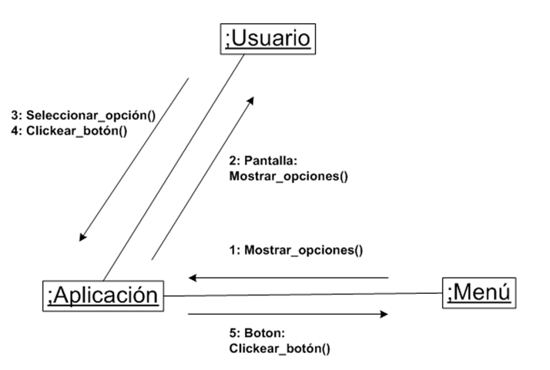
3.5 DIAGRAMA DE COLABORACIÓN
ETIQUETAS DEL MENSAJE
Las etiquetas tienen la siguiente sintaxis:
Predecesor (también llamada sincronización):
En una colaboración, el predecesor es una lista de números de secuencia separadas pos comas y seguidos por una barra (/).
Relação com investidores
Notes:
Marketing & Sales
64% of marketing professionals view webcast as an innovative marketing and communication vehicle
46% of senior marketers predict that half of all corporate events will be hybrid this year
80% of virtual events help build stronger market presence, generate leads & drive awareness and education
Webcast is the #2 most effective marketing tool for nurturing & engaging prospects
Investor Relations (IR)
Corp Comms
Training & Cont. Education
-----
What are the most popular / effective vehicles for marketing activities today & what are the emerging trends?
- How rapidly are webcasts / webinars being adopted by marketing professionals?
- When is a virtual event a webcast vs a web conference?
- Case study: How webcasting is used at Arkadin to reduce budget and extend reach
Sources:
Business to Business B2B - 2012
4 Reasons Your Next Event Should Be a Virtual One – HubSpot, June 2011
Forresters – 2012
The Practicalities of Virtual Events – ON24, June 2011
Navigating the Emerging Gap in Large Conference Calls & Webcast Event Solutions – Wainhouse Research, 2013
4 Reasons Your Next Event Should Be a Virtual One – HubSpot, June 2011
Cost effectiveness
Global Reach
Increase sales
Reinforce brand awareness
Enhance engagement
Continue the conversation
Elongate the life of your event
Reduce carbon footprint
Reduce travel cost

Slide 12
3.5 DIAGRAMA DE COLABORACIÓN
EXPRESIÓN DE SECUENCIA
La expresión de secuencia es una lista de términos de secuencia separados por puntos y seguida por dos puntos (' : '). Cada término representa un nivel de anidamiento procedural dentro de la interacción global.
Relação com investidores
Notes:
Marketing & Sales
64% of marketing professionals view webcast as an innovative marketing and communication vehicle
46% of senior marketers predict that half of all corporate events will be hybrid this year
80% of virtual events help build stronger market presence, generate leads & drive awareness and education
Webcast is the #2 most effective marketing tool for nurturing & engaging prospects
Investor Relations (IR)
Corp Comms
Training & Cont. Education
-----
What are the most popular / effective vehicles for marketing activities today & what are the emerging trends?
- How rapidly are webcasts / webinars being adopted by marketing professionals?
- When is a virtual event a webcast vs a web conference?
- Case study: How webcasting is used at Arkadin to reduce budget and extend reach
Sources:
Business to Business B2B - 2012
4 Reasons Your Next Event Should Be a Virtual One – HubSpot, June 2011
Forresters – 2012
The Practicalities of Virtual Events – ON24, June 2011
Navigating the Emerging Gap in Large Conference Calls & Webcast Event Solutions – Wainhouse Research, 2013
4 Reasons Your Next Event Should Be a Virtual One – HubSpot, June 2011
Cost effectiveness
Global Reach
Increase sales
Reinforce brand awareness
Enhance engagement
Continue the conversation
Elongate the life of your event
Reduce carbon footprint
Reduce travel cost

